Slide 2

Digital Image Processing
Cartoon Recognition: A Case Study on Pokémon Classification
Presenter:
Nguyen Minh Huyen – 20224272
Tran Trang Linh - 20224287

Slide 3
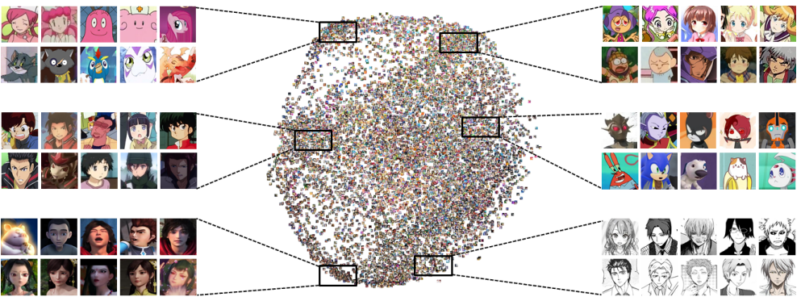
Title 1: Introduction
Challenge: Cartoon images, like Pokémon, have exaggerated features and colors, which make traditional recognition methods ineffective.
Task: Recognize and classify Pokémon into three categories: animal, plant, and other.
Approach: Combine digital image processing (DIP) and deep learning to improve recognition accuracy.

Slide 4

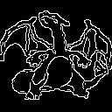


Title 2: Theoretical Background
Edge Detection
Importance: Identifies object boundaries through intensity changes.
Canny Edge Detection: Gaussian smoothing, gradient computation, non-maximum suppression, double-thresholding.
Implementation: apply_edge_detection with OpenCV’s Canny, takes grayscale input and outputs binary edge map.
Result: Accurate edges critical for cartoon analysis.

Slide 5
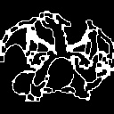
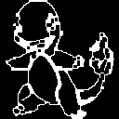
Title 2: Theoretical Background
Morphological Operations
Key Techniques: Dilation, Erosion, Closing.
Purpose: Refines edges, fills gaps, and smoothens boundaries.
Implementation:
Function apply_morphology uses OpenCV's morphology operations.
Objective: Enhance edge continuity by filling gaps or removing noise.

Slide 6
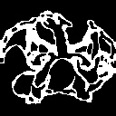
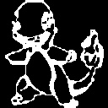
Title 2: Theoretical Background
Thresholding
Method: Otsu’s method to determine optimal thresholding value.
Purpose: Converts grayscale images to binary, improving separation of Pokémon categories.
Implementation: apply_threshold function applies binary thresholding.
Output: Clean, binary images ready for further analysis.

Slide 7

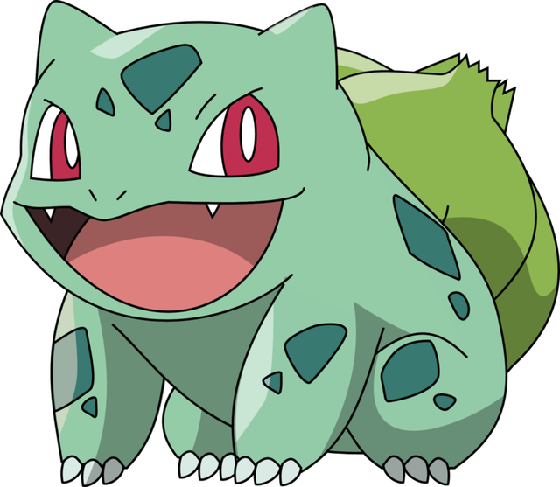
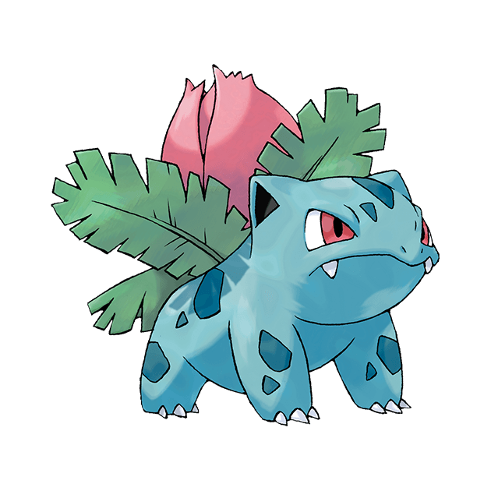
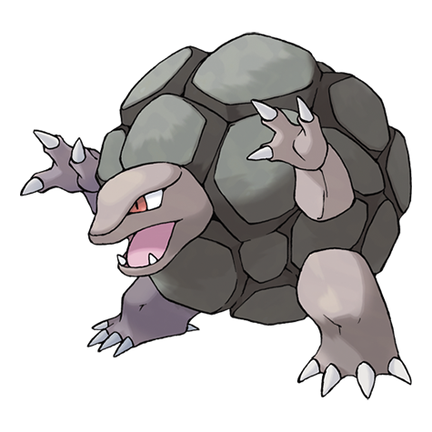
Title 2: Theoretical Background
HSV-Based Classification
Logic:
Green hues classify as "Plant“.
Low brightness/saturation classify as "Other."
All other hues classify as "Animal”.
Implementation:
The classify_based_on_color function computes average HSV values for classification.

Slide 8
Title 3: Methodology
Data Preparation
Dataset
Categories: Animal, Plant, Other.
Distribution: 660 Animal, 108 Plant, 412 Other images.
Preprocessing
Resize: Images resized to 128x128 pixels.
Augmentation: Horizontal flipping, rotation for data augmentation.
Code Implementation: Functions like preprocess_image integrate edge detection, morphological operations, and HSV-based classification.

Slide 9
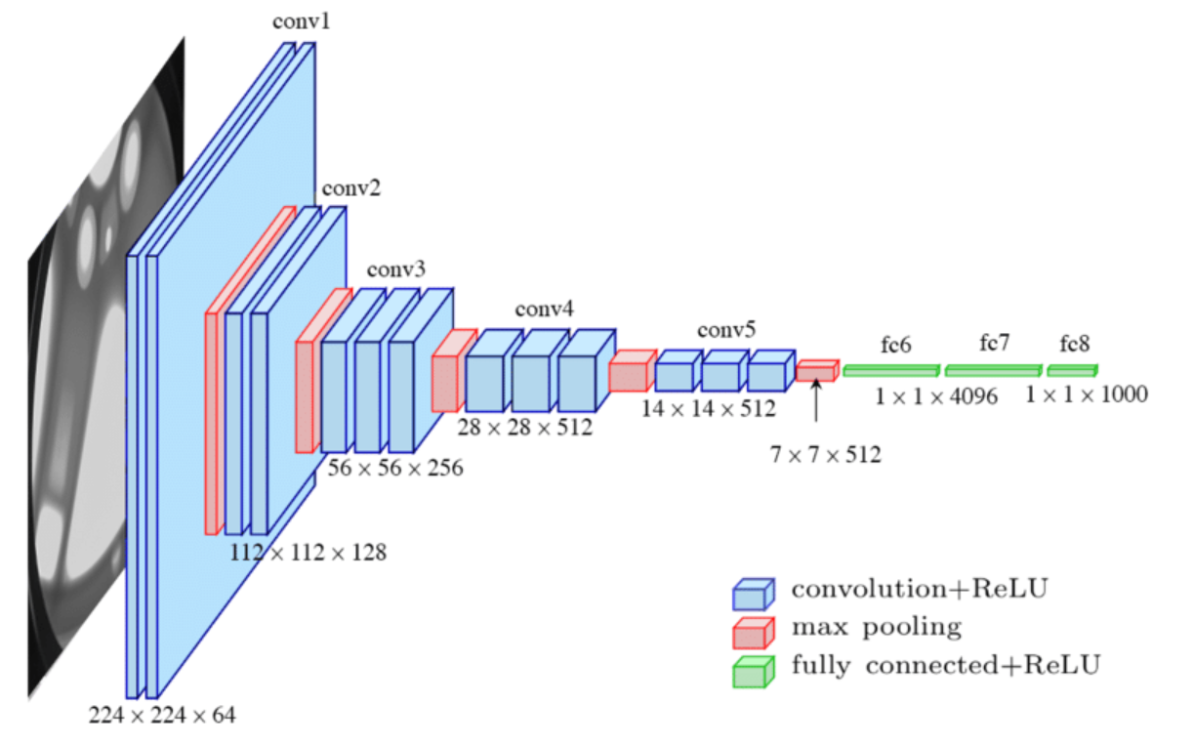
Title 3: Methodology
Model Architecture (CNN)
Convolutional Layers: Extract spatial features using 32 and 64 filters with ReLU activation.
Pooling Layer: MaxPooling (2x2) for downsampling.
Fully Connected Layers: 128 neurons with ReLU activation.
Output Layer: Softmax for 3 categories.

Slide 10
Title 3: Methodology
Model Architecture (CNN)
Training
Optimizer: Adam (Learning rate: 0.001).
Loss Function: Cross-entropy.
Implementation
Model defined in the CNNModel class.
Training via the train_model function.
Evaluation with evaluate_model_with_metrics and metrics like precision, recall, and F1-score.

Slide 11
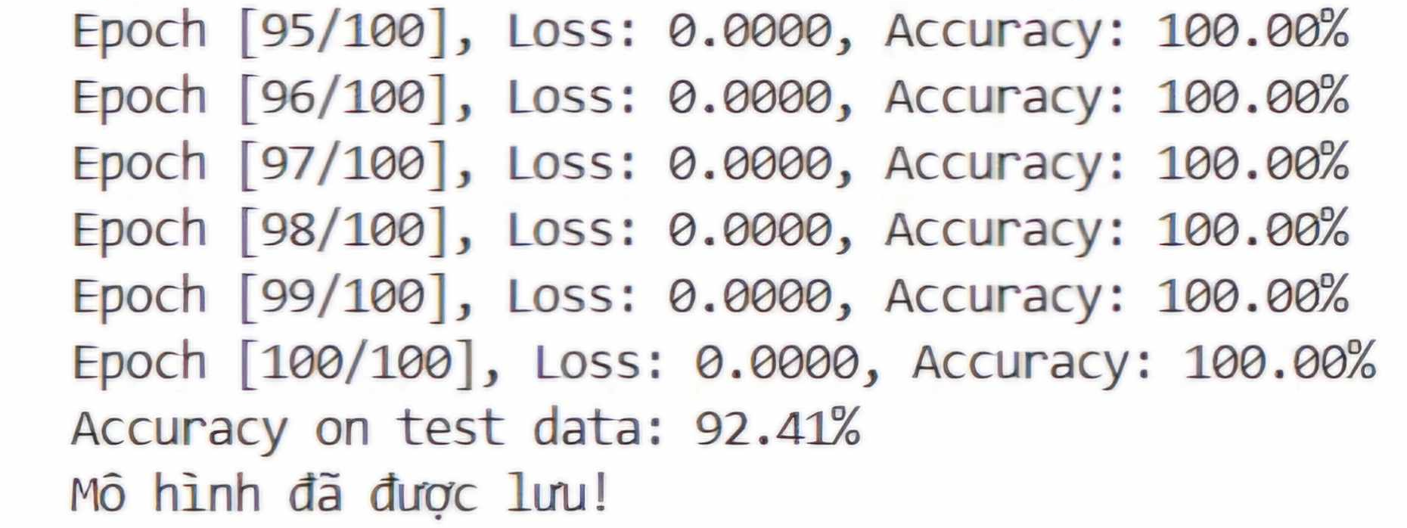
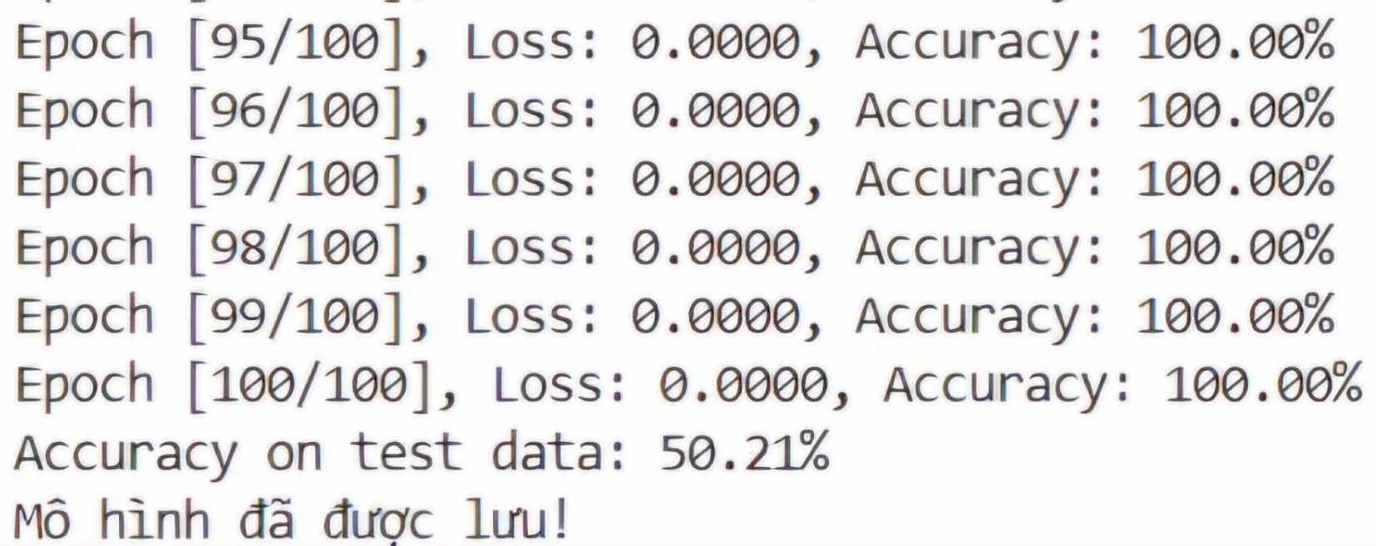
Title 4: Experimental results
Overall Accuracy:
Without DIP: 50.21%
With DIP: 92.41%
Training Time:
12 seconds per epoch
25 minutes for total training

Slide 12
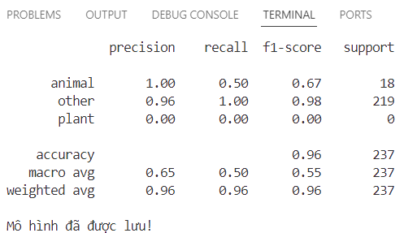
Title 4: Experimental results
Category Performance
Animal: Precision 100%, Recall 50%
Plant: Precision 0%, Recall 0%
Other: Precision 96%, Recall 100%
Implementation:
Results computed using evaluate_model_with_metrics function.

Slide 13
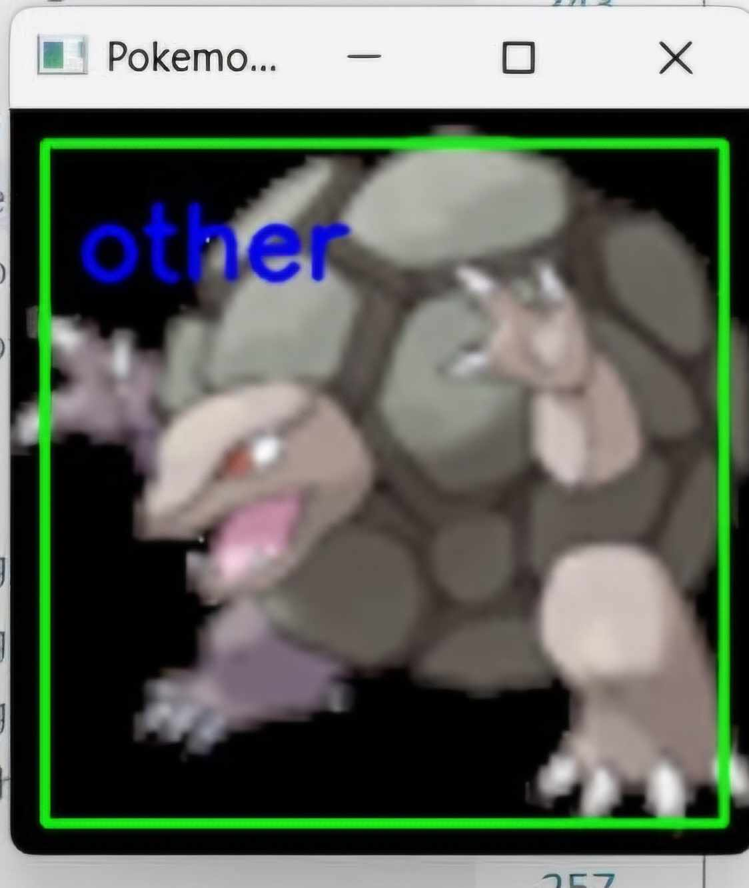
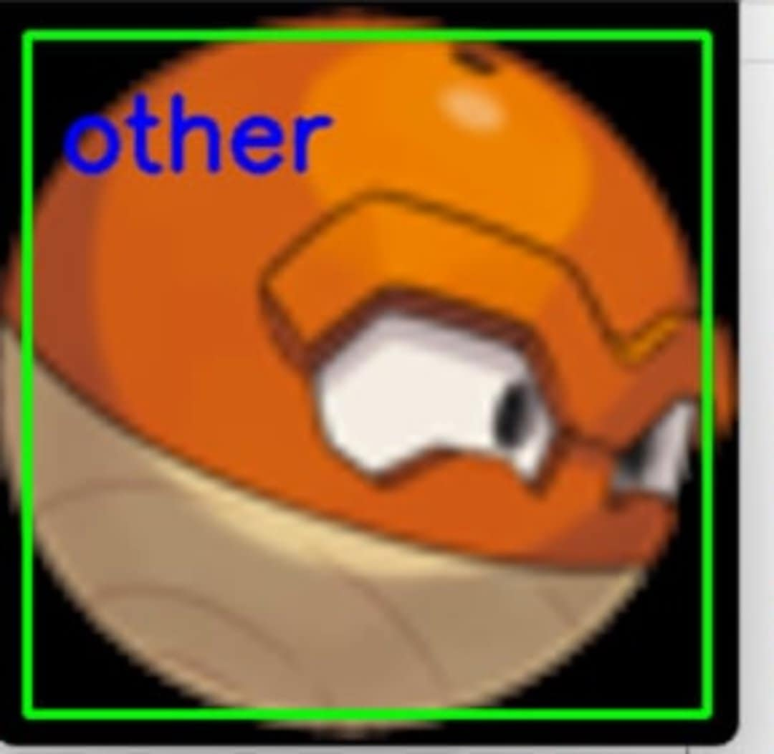
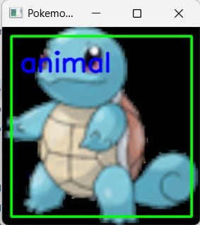
Title 4: Experimental results
Category Performance
Animal: Precision 100%, Recall 50%
Plant: Precision 0%, Recall 0%
Other: Precision 96%, Recall 100%
Implementation:
Results computed using evaluate_model_with_metrics function.

Slide 14
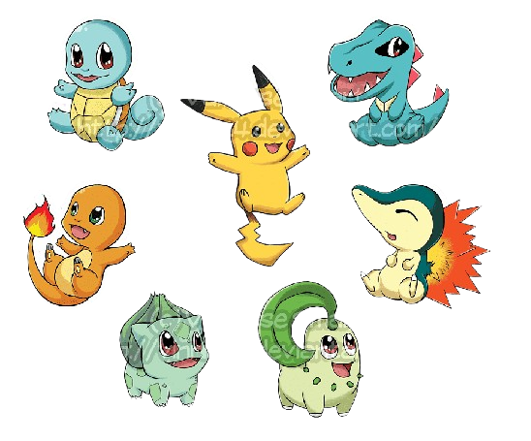
Title 5: Discussion
Strengths
Improved Accuracy: Integration of DIP techniques boosts overall classification performance.
Versatility: Handles diverse Pokémon designs with varying shapes and colors.
Efficiency: Fast processing and training times due to optimized preprocessing steps.
Applicability: Suitable for other cartoon-based datasets beyond Pokémon.

Slide 15
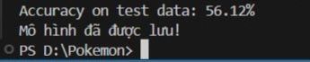

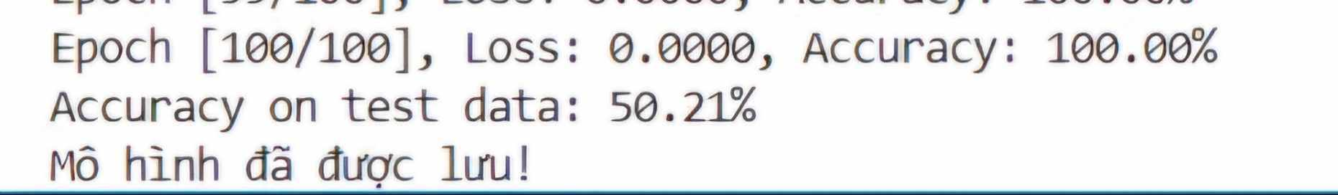
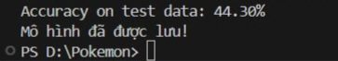
Title 5: Discussion
Challenges
Dataset Imbalance: Fewer samples reduce accuracy and generalization. Labeling Complexity: Manual labeling is prone to errors, especially for hybrid or ambiguous characters.
Preprocessing Effects: Some preprocessing steps may distort or lose important information, impacting performance.
Overfitting Risk: Higher risk of overfitting for larger classes (e.g., "Animal").

Slide 16
Title 6: Conclusion and Future Work
Conclusion:
Combining DIP techniques with CNNs effectively classified Pokémon images.
Preprocessing pipeline improved accuracy.
Challenges: dataset imbalance and complex color patterns.
Future Work:
Expand the dataset, especially for the Plant category.
Experiment with advanced techniques like GANs to generate synthetic data.
Improve color classification using machine learning models.
Extend the method to other datasets or real-world applications like medical imaging.

Slide 17
THANK YOU !

